Slide 1

TRƯỜNG CAO ĐẲNG LÝ TỰ TRỌNG TP. HỒ CHÍ MINH

Slide 2

KHOA KHOA HỌC CƠ BẢN

Slide 3

ỦY BAN NHÂN DÂN THÀNH PHỐ HỒ CHÍ MINH
TRƯỜNG CAO ĐẲNG LÝ TỰ TRỌNG TP. HỒ CHÍ MINH
Bậc đào tạo: TRUNG CẤP CHUYÊN NGHIỆP
Tên giảng viên: LÊ NGUYỄN MỸ TRÂM

Slide 4
Good afternoon class 19T2.

Slide 5
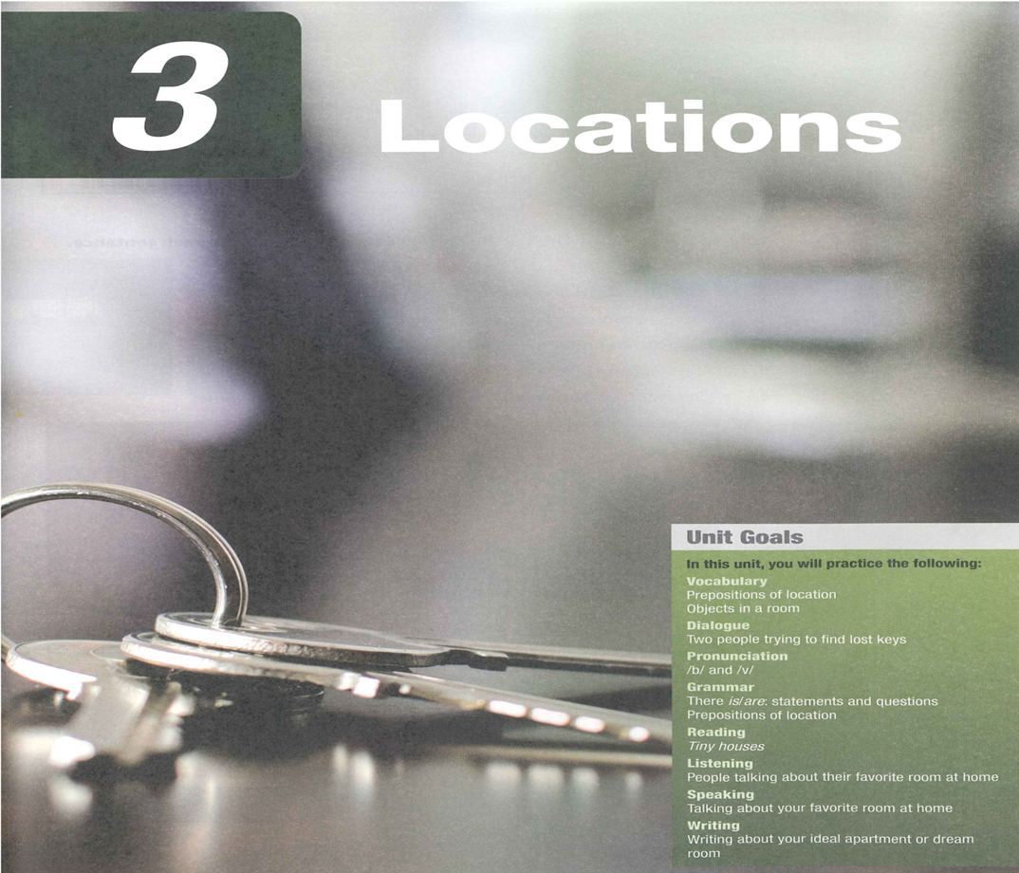

Slide 6
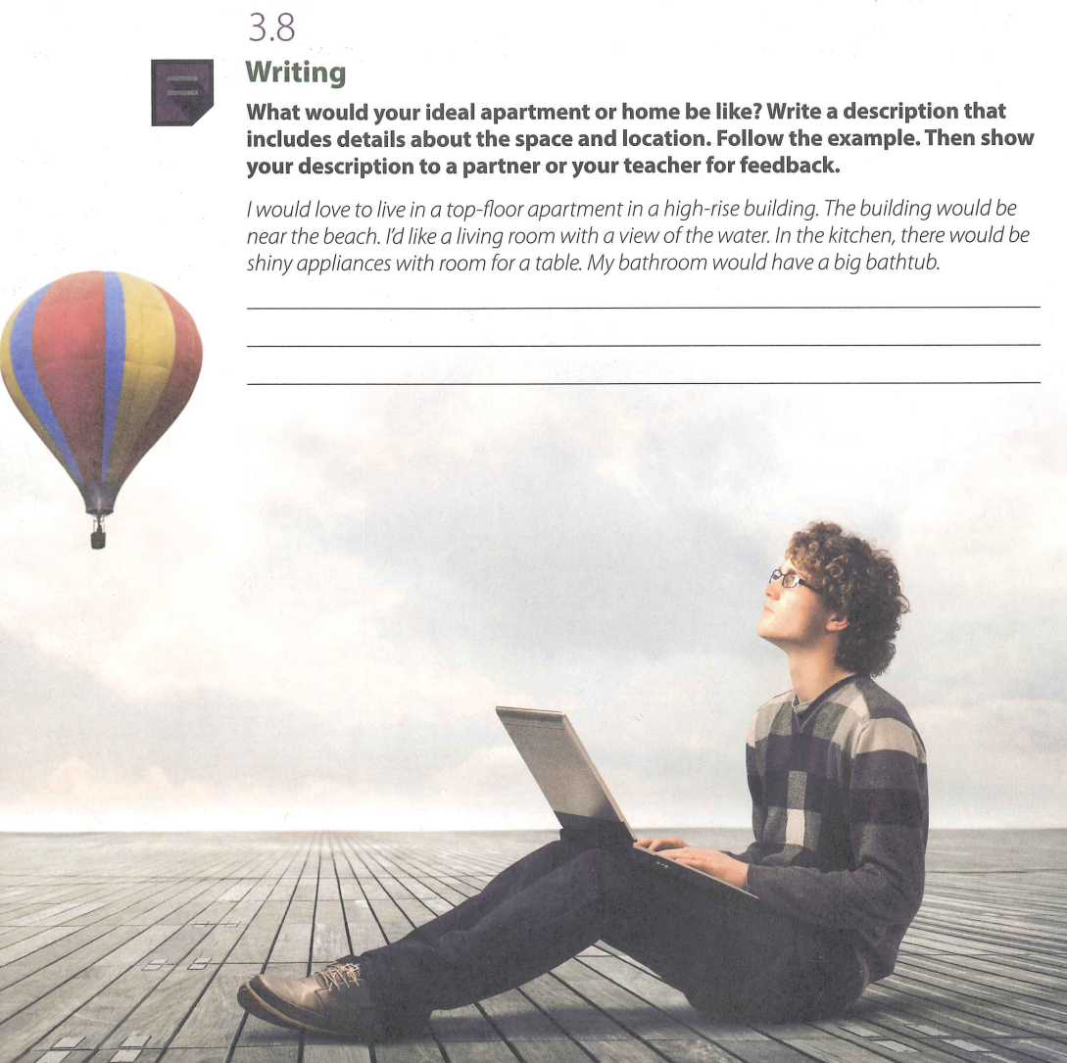

Slide 7
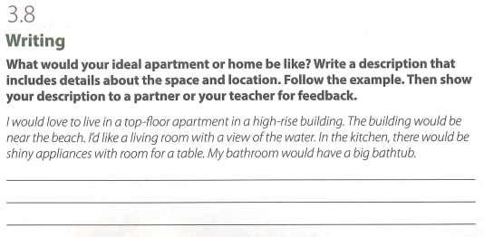

Slide 8

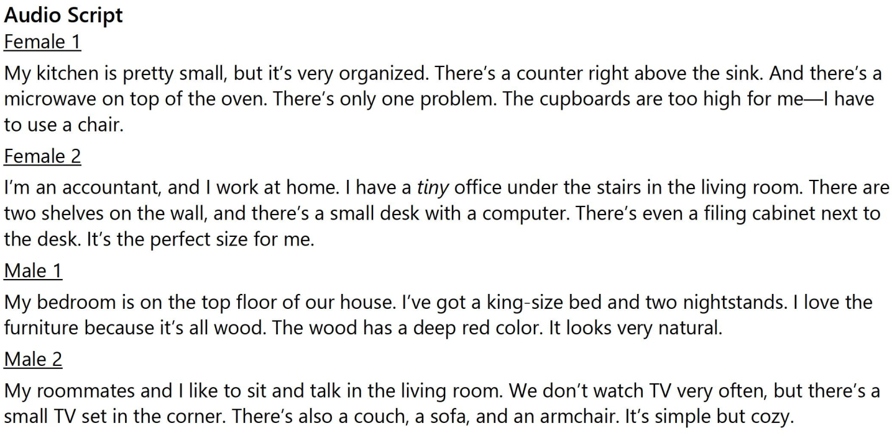

Slide 9
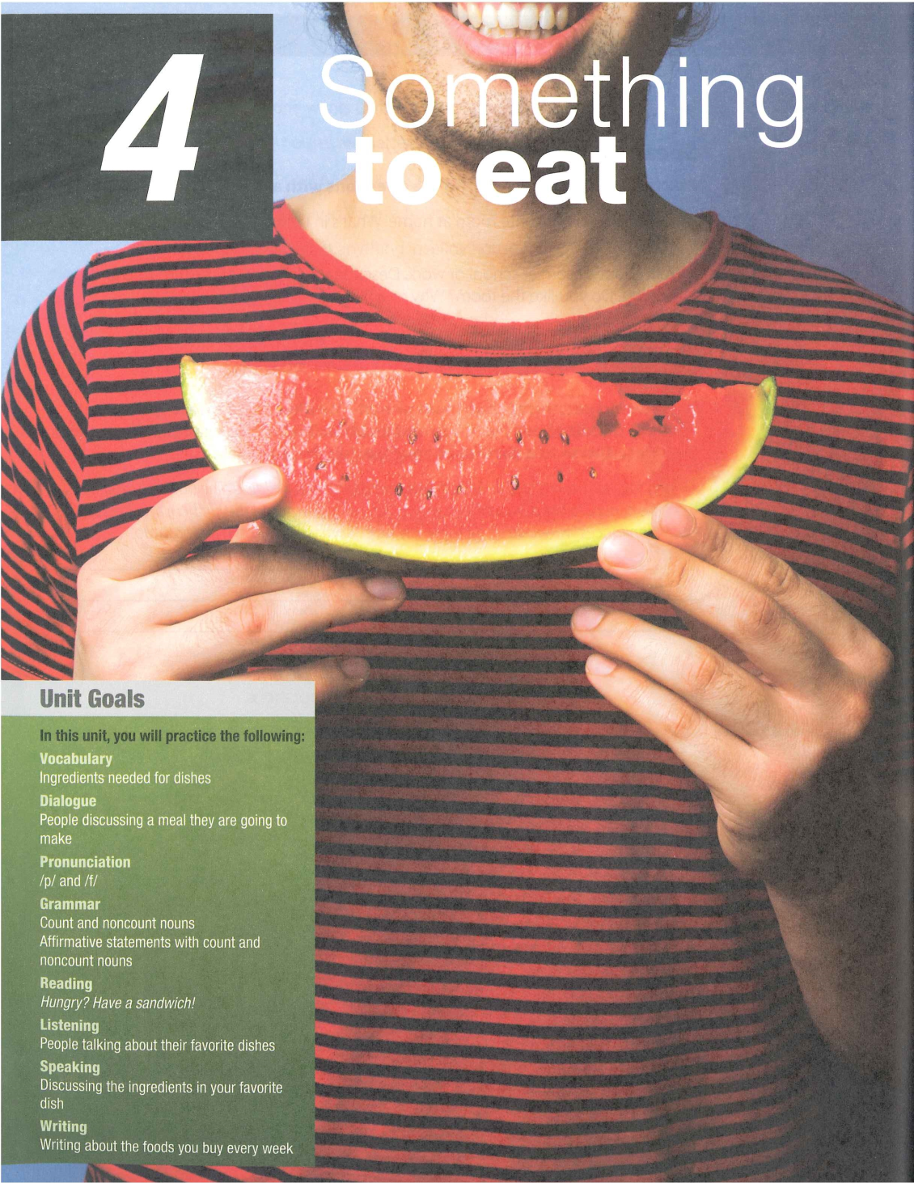

Slide 10
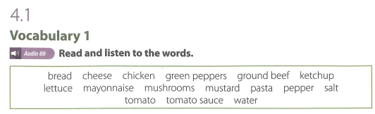
UNIT 4: SOMETHING TO EAT

Slide 11
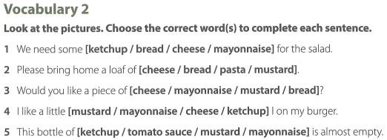

Slide 12
VOCABULARY 2 (KEY)
We need some [ketchup / bread / cheese / mayonnaise] for the salad.
Please bring home a loaf of [cheese / bread / pasta / mustard].
Would you like a piece of [cheese / mayonnaise / mustard / bread]?
I like a little [mustard / mayonnaise / cheese / ketchup] I on my burger.
This bottle of [ketchup / tomato sauce / mustard / mayonnaise] is almost empty.

Slide 13
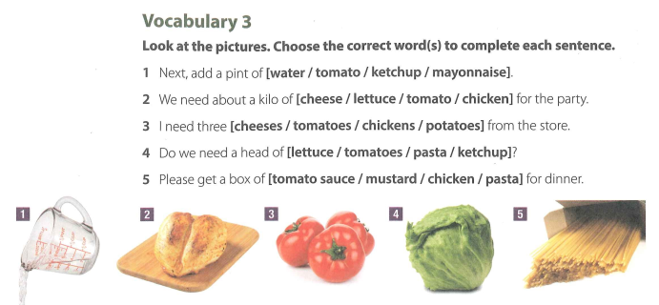

Slide 14
VOCABULARY 3 (KEY)
Next, add a pint of [water / tomato / ketchup / mayonnaise].
We need about a kilo of [cheese / lettuce / tomato / chicken] for the party.
I need three [cheeses / tomatoes / chickens / potatoes] from the store.
Do we need a head of [lettuce / tomatoes / pasta / ketchup]?
Please get a box of [tomato sauce / mustard / chicken / pasta] for dinner.

Slide 15
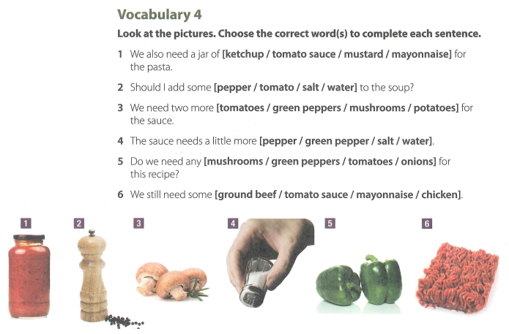

Slide 16
VOCABULARY 4 (KEY)
We also need a jar of [ketchup / tomato sauce / mustard / mayonnaise] for the pasta.
Should I add some [pepper / tomato / salt / water] to the soup?
We need two more [tomatoes / green peppers / mushrooms / potatoes] for the sauce.
The sauce needs a little more [pepper / green pepper / salt / water].
Do we need any [mushrooms / green peppers / tomatoes / onions] for this recipe?
We still need some [ground beef / tomato sauce / mayonnaise / chicken].

Slide 17
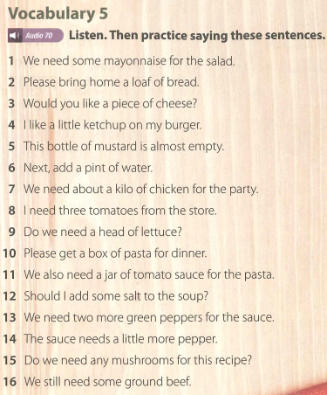

Slide 18
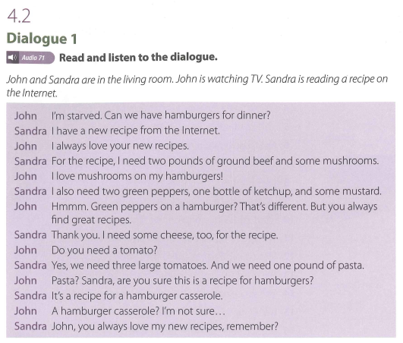

Slide 19
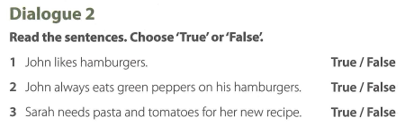

Slide 20
Dialogue 2 (Key)
1. John likes hamburgers.
-> True.
2. John always eats green peppers on his hamburgers.
-> False.
3. Sarah needs pasta and tomatoes for her new recipe.
-> True.

Slide 21

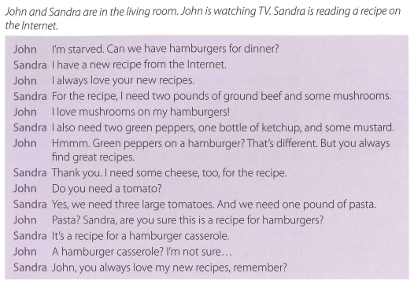

Slide 22
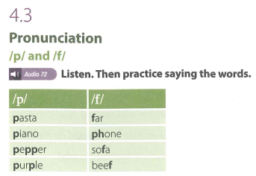

Slide 23
Thank you very much
for
your cooperation.

